Slide 1
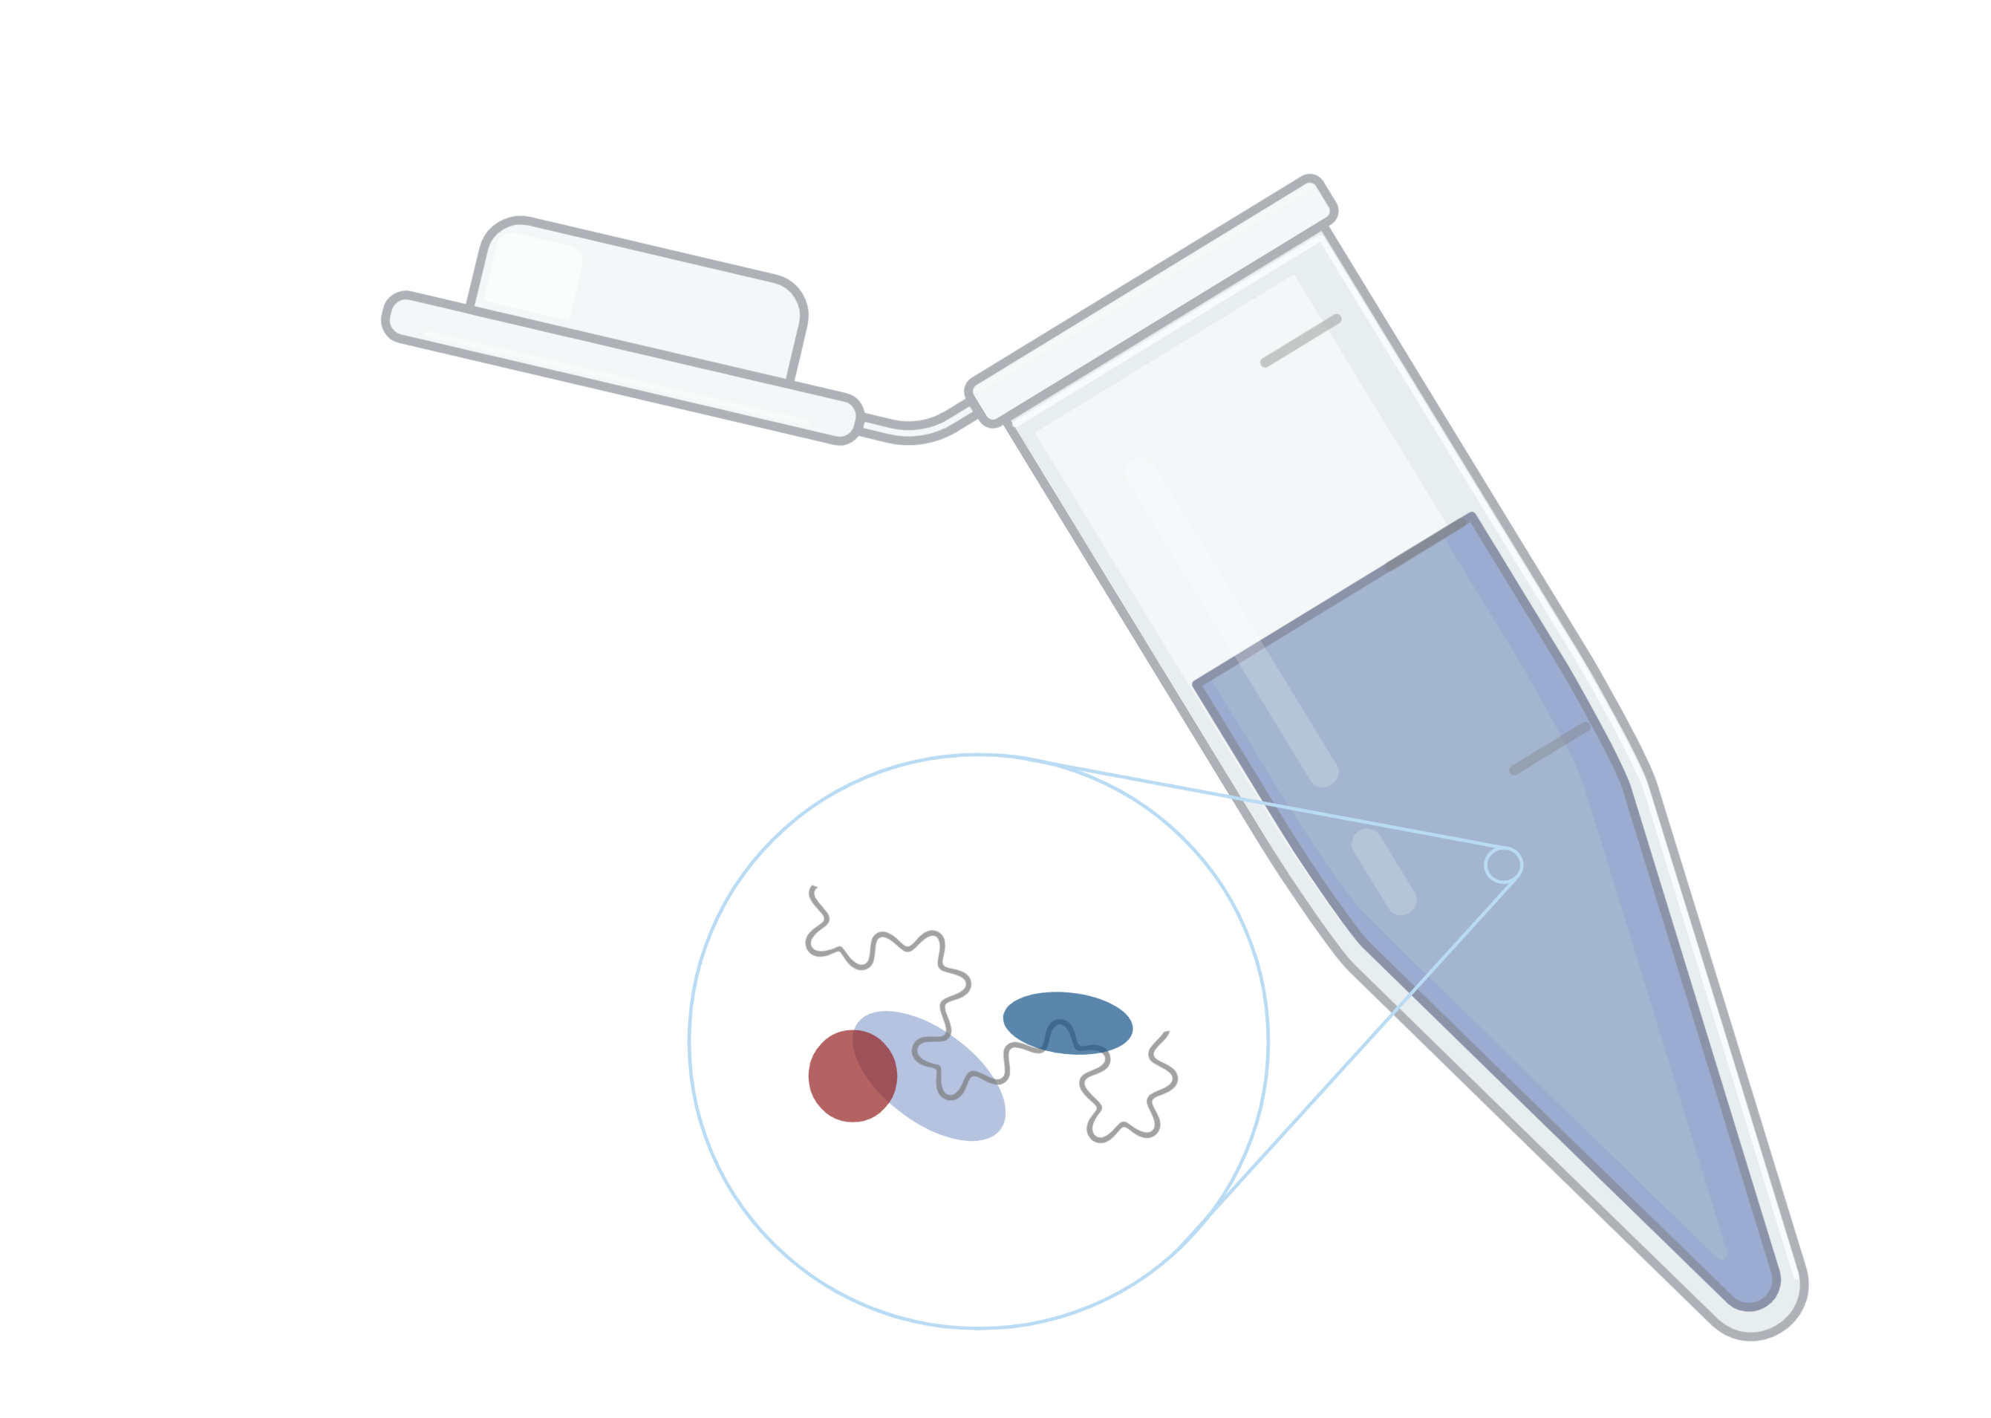
Proteome-wide Screen for RNA-dependent Proteins in HeLa cells during Interphase & Mitosis
Data Analysis Project 2022
Team 5: Laure Herfurrth, Katharina Lotter, Kiren Nadeem, Marie Lulu Salein
Supervisors: Dr. Maïwen Caudron-Herger, Niklas Engel
Molecular Biotechnology B.Sc. Ruprecht Karls University of Heidelberg
19.07.2022
Created with BioRender.com

Slide 2
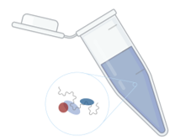
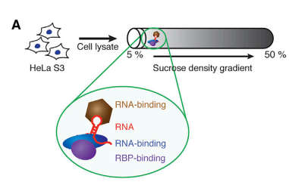
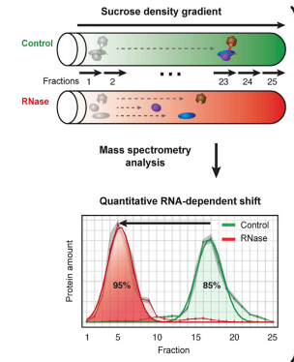
What are RBPs?
RNA binding proteins
RNA binding protein
=Proteins which bind RNA
2. RNA dependent proteins
=do not bind directly, but their interactome depends on RNA
Kelaini, S., C. Chan, V. A. Cornelius and A. Margariti (2021). "RNA-binding proteins hold key roles in function, dysfunction, and disease." Biology 10(5): 366
Notes:
Left shift: loss of interaction partners
Right shift: gain of interaction partners

Slide 3
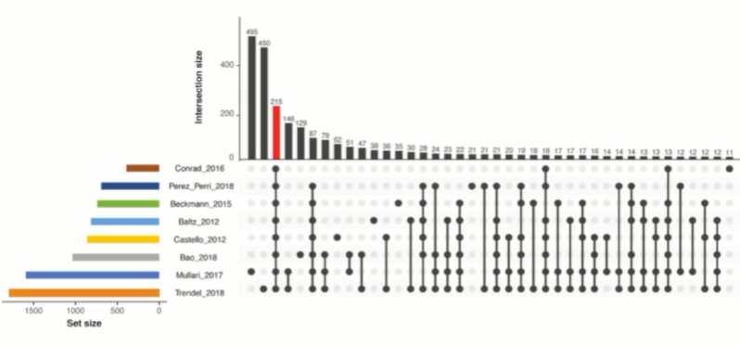
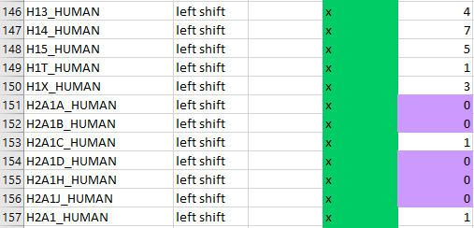
Why is that important? - Study gap on RBPs
RNA binding proteins
RBP score of the proteins we found
Caudron-Herger, M., S. F. Rusin, M. E. Adamo, J. Seiler, V. K. Schmid, E. Barreau, A. N. Kettenbach and S. Diederichs (2019). "R-DeeP: proteome-wide and quantitative identification of RNA-dependent proteins by density gradient ultracentrifugation." Molecular cell 75(1): 184-199. e110
Notes:
Only 215 common proteins so far
High need for proteome wide studies dedicated to the identification of RBPs

Slide 4
Our Project
Our Goal
Analysis of the HeLa Interphase & Mitosis data set
Which proteins are RBPs & RNA-dependent?
Identification of both RNA-binding and RNA-dependent proteins
Regression analysis: Can we predict if a proteins is RNA-dependent by looking at its other traits?
Can we find RBPs associated with Actin?
What properties do the RBPs have in common?
Comparision with the R-DeeP database and the UniProt database

Slide 5
Timeline
Milestones
Prepare Dataset for analysis
better understanding of biological question and project goal
Normalization & Reproducibility
Data Cleanup
Maxima & Shifts
Clustering
& Database
comparison
Statistical testing
Regression Analysis
Notes:
This was our initial timeline, in the end we did not exactly stick to it, but we will show you what we did

Slide 6
Data Cleanup
Data Reduction
Data cleanup & reduction
Literature review II
Data cleanup & reduction II
Data exploration
buffer Week
Data modellig
Data modelling II
Repeat with 2nd Dataset
&
Compare both Datasets
Wrapup data analysis
presentation & report
finish presentation & report
Data Cleanup & Data Reduction
Delete proteins without any values or without values in either RNase or control group
2nd week
3rd week
4th week
5th week
6th week
7th week
8th week
9th week
→ 7081 Proteins left after data cleanup
Notes:
Details der Schritte hier rein

Slide 7
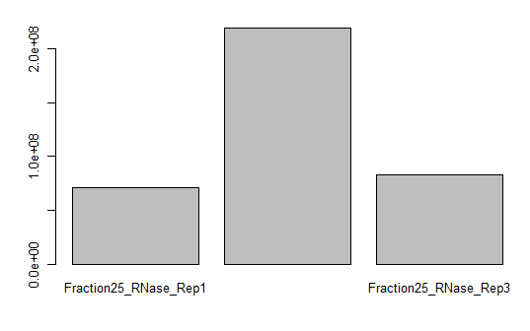
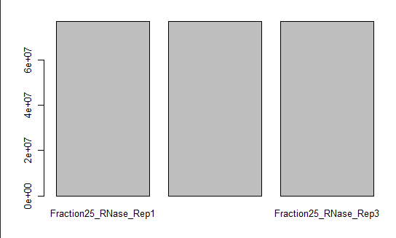
Data Cleanup
Normalization
Problem: each measurement was made with a different amount of protein
→ Amount has to be similar within replicates
Solution
Which two replicates have the closest mean values?
e.g. Rep1 & Rep2 → calculate the mean of the means
Set the mean of Rep3 to the value calculated above
Protein amount was set to 100
Notes:
100: amount is now interpretable as a percentage → will be used for the determination of local maxima

Slide 8
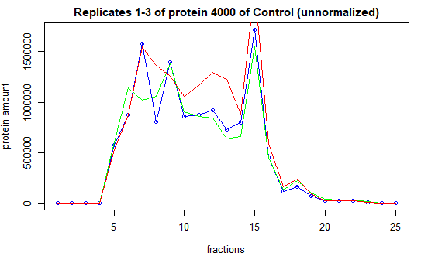
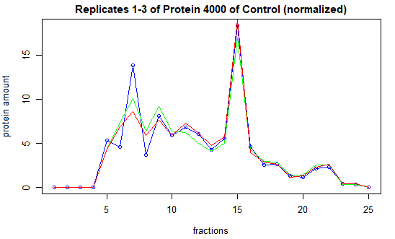
Data Cleanup
Normalization
Normalization
Protein Amount in Rep1, Rep2, Rep3 before normalization
Rep1
Rep2
Rep3
Protein Amount in Rep1, Rep2, Rep3 after normalization
Rep1
Rep2
Rep3

Slide 9
Data Cleanup
Removal of batch effects
Batch Effect
=variations in the data/outliers caused by technical means
No biological significance
Can result in false conclusions
Batch Effects were found in 23 proteins!
Solution
Comparing the values of all 3 Reps for each fraction
Rep1 | Rep2 | Rep3
0 | 0 | 0.75
Rep1 | Rep2 | Rep3
0.67 | 0.98 | 0
Rep3=0
Rep3=(0,67+0,98):2=0,825

Slide 10
Reproducibility
Reproducibility
Do the maxima in all three replicates align?
Maxima have to be in the same fraction (+/-1)

Slide 11
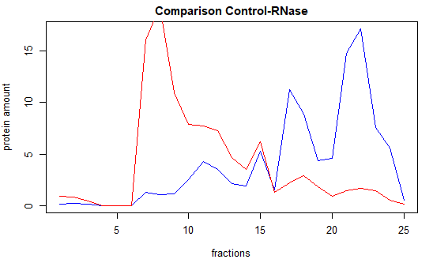
Maxima
Maxima
Global Maxima
Highest amount of protein
Local Maxima
Shifting protein which shows global and local maxima
RNase
Control
Higher value than the 2 fractions to each side
At least 5 % of the total protein amount

Slide 12
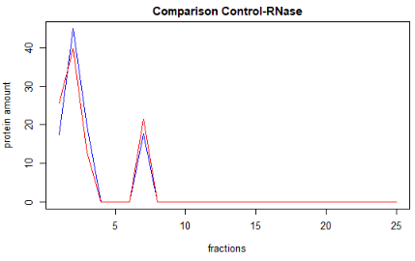
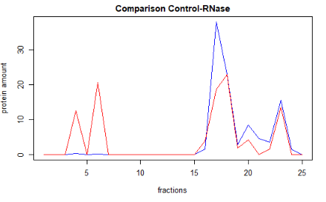
Shifts
Shifts
1. Full Shift
= Maxima of control and RNase have a difference of at least 2 fractions in the x-direction
No shift
2. Partial Shift

Slide 13
Shifts
Shifts: Results
= Maxima of Control and RNase have a difference of at least 2
fractions in the x-direction
Proteins | Interphase | Mitosis
Shift in global maximum | 1118 | 1045
Shift in local maxima | 1902 | 1555
Total number of shifting proteins | 2107 | 1828

Slide 14
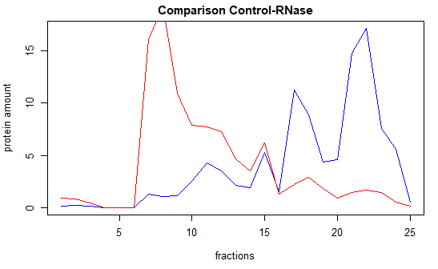
Statistical testing
T-test: Is the y-shift significant?
Assuming normality due to reproducibility
Analysis of y-shifts
2-sided t-test
α = 0.5
Significant if p < 0.025
y-shift
x-shift

Slide 15
Statistical testing
T-test: Results
Proteins | Interphase | Interphase after statistical testing | Mitosis | Mitosis after statistical testing
Shift in global maximum | 1118 | 869 | 1045 | 641
Shift in local maxima | 1902 | 1471 | 1555 | 1081
Total number of shifting proteins | 2107 | 1653 | 1828 | 1244
x-shift

Slide 16
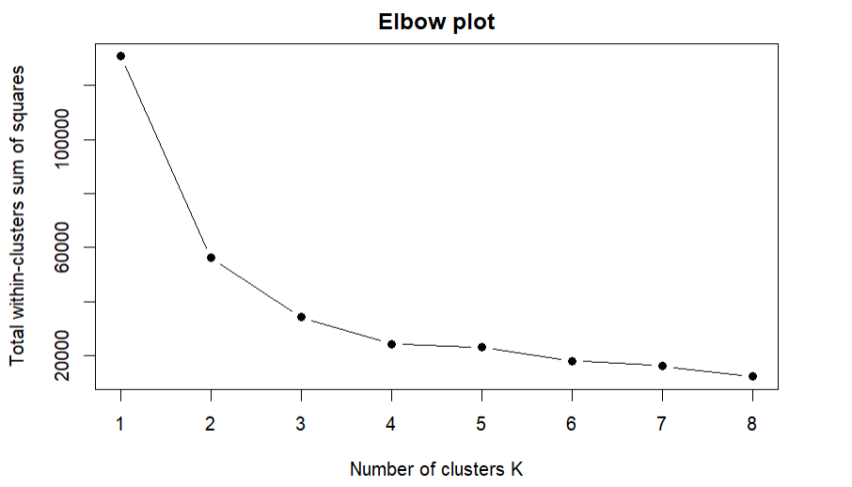
k-means clustering
k-means clustering
x-shift global maximum during interphase clustered against x-shift global maximum during mitosis
left shift x > 0; right shift x < 0

Slide 17
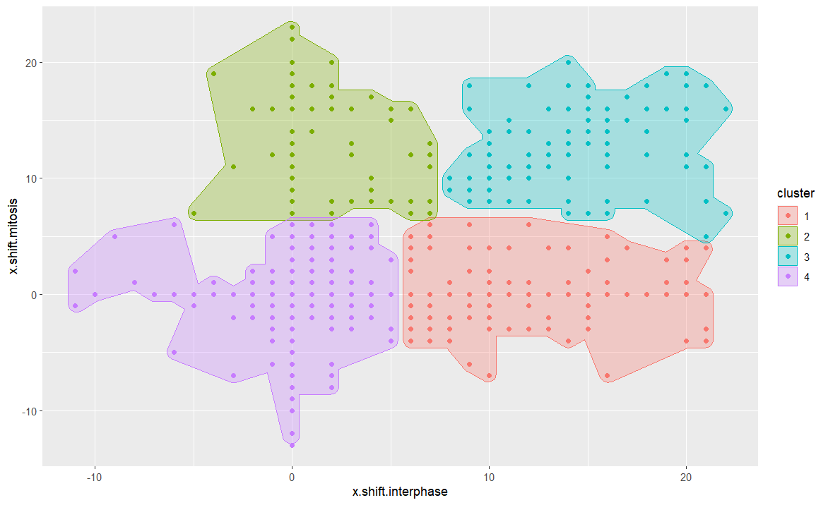

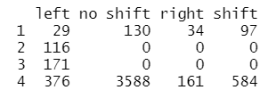
k-means clustering
Clustering results
Interphase
Mitosis

Slide 18
Regression analyisis
Regression Analysis
Idea: Can we predict if a protein is an RBP by looking at the correlation of the averaged curves?
no shift → high correlation
shift → low correlation

Slide 19
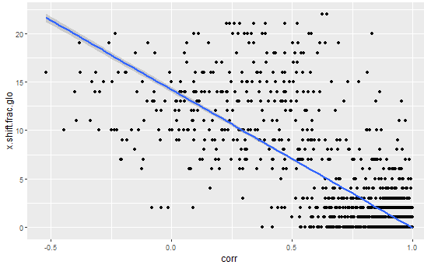
Regression analyisis
Can we predict the x shift of the global maximum by looking at the correlation of the averaged curves?
y = -14.2913 + 14.2124x rmse= 1.91

Slide 20
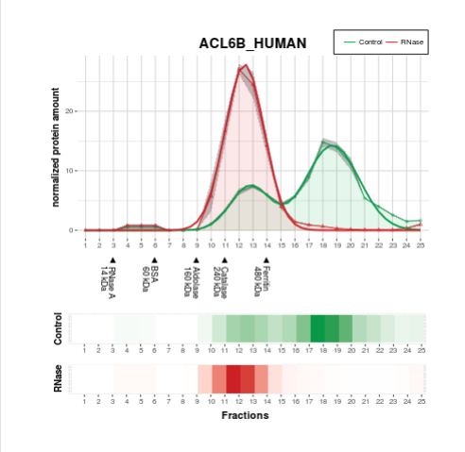
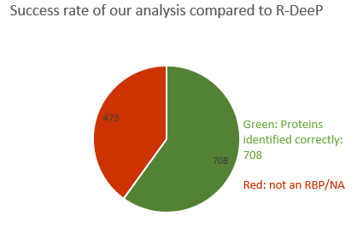
Database comparison
What do the RBPs have in common?
Comparison with R-DeeP
Analysis of proteins which had a full shift (Interphase)
Shifting protein as shown by R-DeeP
Control
Rnase
(Caudron-Herger, Rusin et al. 2019)
Success rate
Analysis of 1181 proteins: 59.9%
Notes:
For an estimate/validation of our results we compared which RBPs we found to the R-DeeP database
We compared our results with the R-DeeP database, who obtained ist data by the same experimental methods
We found an overlap of x proteins which we had also defined to be RBPs
For x protein was no data available and for x proteins R-DeeP did not find an RBP (this might be due to differences in statistical testing)

Slide 21
Database comparison
What do the RBPs have in common?
Comparison with R-DeeP
Analysis of proteins which had a full shift (Interphase)
RBP Score
=How many times has the protein been identified as an RBP?
→92 proteins which had not been identified previously!
Notes:
Next (also using R-DeeP) we wanted to see, what other studies had found
For some proteins it was clear they were an RBP, as they had been identified by multiple studies previously
Others however had not been previously identified as an RBP, showing once again the study gap in this field, but also the advantage of the method, which not only detects RNA binding, but also RNA dependent proteins

Slide 22
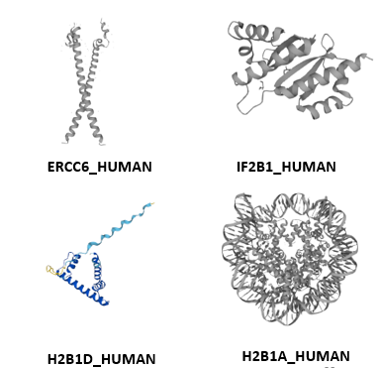
Database comparison
What do the RBPs have in common?
Comparison with UniProt
Funktion
chromatin & cytoskeleton organization
cell division & cell cycle regulation
brain development & embroynic development
native and adaptive immunity
transcription and translation regulation
ribosome function
rRNA and mRNA metabolism
The UniProt Consortium
UniProt: the universal protein knowledgebase in 2021
Nucleic Acids Res. 49:D1 (2021)
Notes:
Coiled coil and intriniscally disordered regions (last ones enable an unspecific binding to RNA

Slide 23
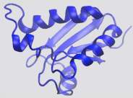
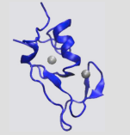
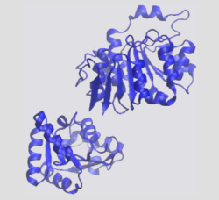
Database comparison
Common features of RBPs
Common Domains
RNA recognition motif
→ 105 Proteins
Zinc Finger
→89 Proteins
Dead/Deah Domain/Helicase Domain
→69 Proteins
Corley, M., M. C. Burns and G. W. Yeo (2020). "How RNA-binding proteins interact with RNA: molecules and mechanisms." Molecular cell 78(1): 9-29
Notes:
Most proteins contained intrinsically disordered regions!
Coiled coil: 81 proteins

Slide 24
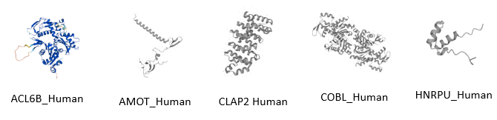
Database comparison
Actin-associated proteins
Functions
Chromatin binding & remodelling
Cytoskeleton organization
Embryonic development & angiogenesis
Microtubule organization
Cell division
Actin polymerization
The UniProt Consortium
UniProt: the universal protein knowledgebase in 2021
Nucleic Acids Res. 49:D1 (2021)
Notes:
18 Proteins associated with actin

Slide 25
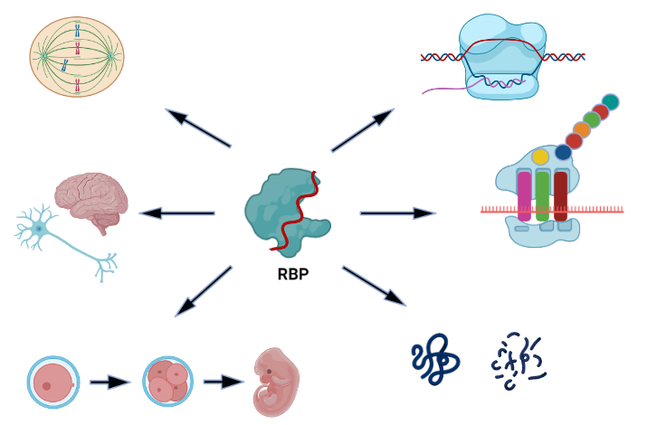
Results
Conclusion & Outlook
Cytoskeleton
Transcription
Brain development
Translation
mRNA stability & degradation
Embroynic development
Created with BioRender.com
Notes:
By determining the maxime in protein samples that were left untreated or treated with RNAse and looking for shifts, we were able to determine which proteins bind RNA/whose interactome depends on RNA
They can occur in both phases of the cell cycle, or just in one of them, showing they respond to cellular and environmental stimuli, thereby enabeling a fine tuned regulation of RNA in all phases of the cell cycle.
RBPs occur in Mitosis and Interphase
Can be cell-cycle dependent or expressed constitutively
Right shifts & left shifts
Left shift: Protein loses interaction partners after Rnase treatment → most likely directly RNA binding
Right shift: Protein gains interaction partners: RNA dependent, by loosing RNA other binding sites could become available
RBPs as an opportunity: involved in almost all cellular processes
Targeting RBPs could introduce a fundamental shift in medicine

Slide 26
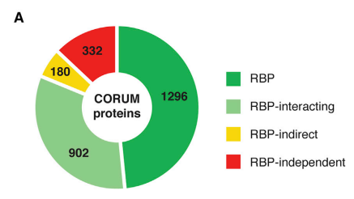
Sucrose Density Gradient Method - identification of new RBPs and RNA-dependent proteins
Caudron-Herger, M., S. F. Rusin, M. E. Adamo, J. Seiler, V. K. Schmid, E. Barreau, A. N. Kettenbach and S. Diederichs (2019). "R-DeeP: proteome-wide and quantitative identification of RNA-dependent proteins by density gradient ultracentrifugation." Molecular cell 75(1): 184-199. e110
If the protein is RNA dependent it will dissociate and migrate to a different fraction
Left shift: loss of interaction partners
Right shift: gain of interaction partners
Information on the quantitiy of the fraction that is associated with RNA
→ strategy to gain insight on RNA function by protein analysis
Notes:
Why is it important to know more about RBPs → severe diseases when malfunctioning

Slide 27
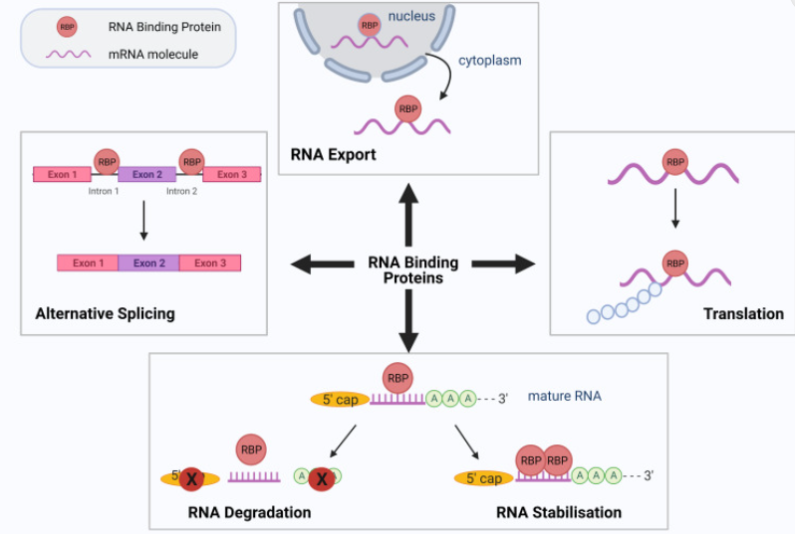
What do they do?
RNA binding proteins
Essential for gene expression (translation, transcription)
Transcription factors
Alternative splicing
Stabilization & Degradation of RNA
Cytoskeleton organization
Developmental processes
Cell cycle regulation
Notes:
RNA is not alone
During every step of RNA metabolism RBPs are associated with RNA
Cooperative & antagonistic interactions
Dynamic associations
→fine-tuned regulation of their RNA targets

Slide 28
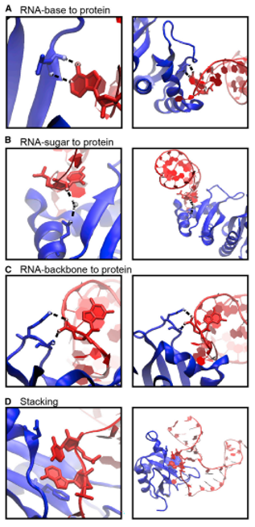
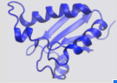
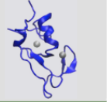
How do they bind RNA?
RNA binding proteins
Unspecific interactions Hydrogen bonds and stacking interactions
most common domains
Interaction
Dynamic
Cooperative & antagonistic
Heterogenous binding domains
Changes in response to cellular and environmental stimuli
RNA recognition motif (RRM)
Zinc finger binding domain
Caudron-Herger, M., S. F. Rusin, M. E. Adamo, J. Seiler, V. K. Schmid, E. Barreau, A. N. Kettenbach and S. Diederichs (2019). "R-DeeP: proteome-wide and quantitative identification of RNA-dependent proteins by density gradient ultracentrifugation." Molecular cell 75(1): 184-199. e110
Corley, M., M. C. Burns and G. W. Yeo (2020). "How RNA-binding proteins interact with RNA: molecules and mechanisms." Molecular cell 78(1): 9-29
Corley, M., M. C. Burns and G. W. Yeo (2020). "How RNA-binding proteins interact with RNA: molecules and mechanisms." Molecular cell 78(1): 9-29
Notes:
RNA recognition motiv
90 amino acids
Definition
RNA binding
RNA dependent (interactome depends on RNA)
Amino acid preferences:
Regression analysis: can we predict if a protein is RNA dependent by looking at ist domains and its amino acid preferences
How many other traits (e.g. the isoelectric point) do we have to include to make accurate predictions?
Comparison with protein databases: later: what other traits do the RBPs we identify have in common
Enable a fine tuned regulation of RNA
We looked at 2 phases of the cell cycle to see if we could identify changes

Slide 29
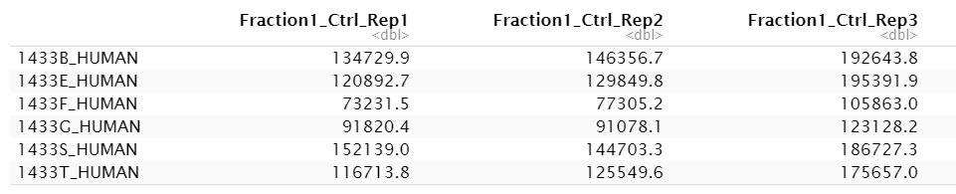
The HeLa Interphase dataset
The dataset
3 replicates with control sample
+ 3 replicates with RNase sample
separated into 25 fractions
Measurements were made in triplicates!
→ 3*3*25 = 150 columns
rows = proteins (7086)
Amount of protein in fraction 1 of replicate 1 with control sample
Notes:
To-do: kurze Definition: was ist eigentlich interphase?
Data frame with 7086 rows and 150 columns
Rows = proteins
Col = Fraction 1-25 for a replicate of control or rnase sample
Values in Dalton?

Slide 30
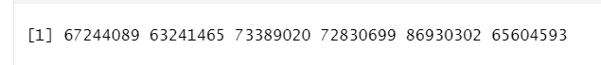
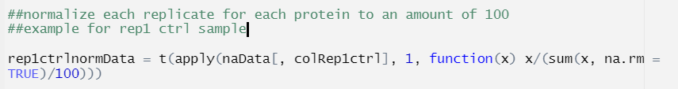

Statistical properties
The dataset
every 6th measurement is part of one replicate
Different amounts of protein in replicates
many zeros

Slide 31
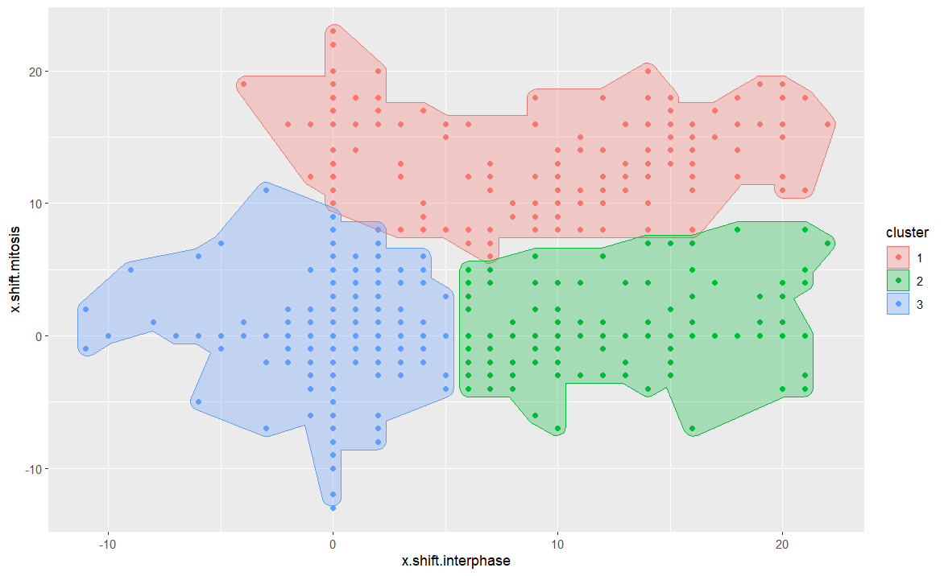
k-means with additional variable
add the number of shifts in interphase and mitosis
contributes to cluster structure, but does not improve wss

Slide 32
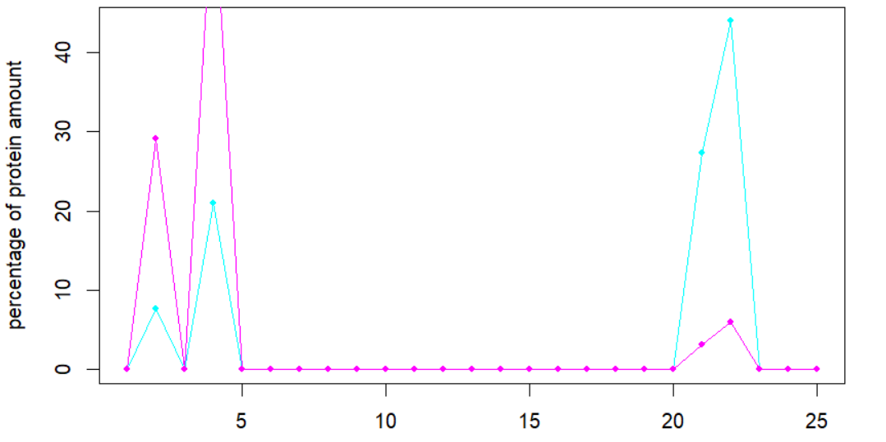
Large shifts

Slide 33
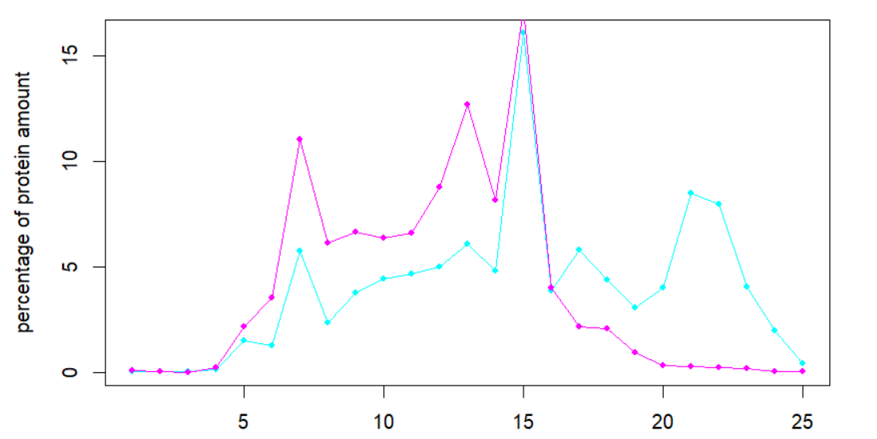
Only local maximum shift

Slide 34


Matrices for looking for local shifts
Control
RNase
0 | 0 | 0 | 0 | 13 | 0 | 0 | 0
0 | 0 | 0 | 0 | 0 | 0 | 0 | 0
9 | 0 | 0 | 0 | 0 | 14 | 0 | 0
0 | 0 | 0 | 0 | 0 | 0 | 0 | 0
0 | 10 | 0 | 0 | 0 | 0 | 0 | 0
0 | 0 | 0 | 0 | 0 | 0 | 15 | 0
0 | 0 | 0 | 0 | 0 | 0 | 0 | 0
0 | 0 | 0 | 0 | 0 | 0 | 0 | 0
0 | 10 | 0 | 0 | 0 | 0 | 0 | 0
0 | 0 | 0 | 0 | 0 | 0 | 0 | 0
9 | 0 | 0 | 0 | 0 | 14 | 0 | 0
0 | 0 | 0 | 0 | 0 | 0 | 0 | 0
0 | 0 | 10 | 0 | 0 | 0 | 0 | 0
0 | 0 | 0 | 0 | 0 | 0 | 15 | 0
0 | 0 | 0 | 0 | 0 | 0 | 0 | 0
0 | 0 | 0 | 0 | 0 | 0 | 0 | 0

Slide 35
Why local maxima?
Identify proteins with partial shift
Improved approach to test for reproducibility by comparing maxima
Y-thresholds to avoid to many false positives

